Slide 1
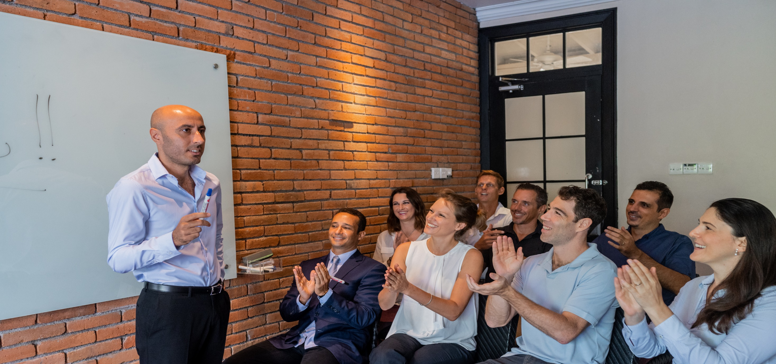


STARTUP SCALING
BOOTCAMP
WITH TAREK EL GAMMAL

Slide 2
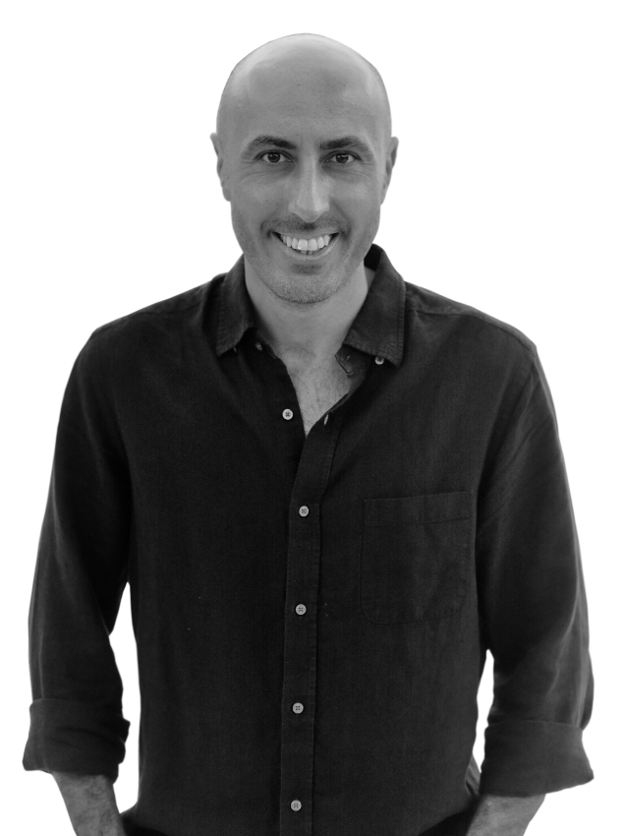


WHO IS TAREK EL GAMMAL
Startup scaling expert & coach
Startup selection panel member
Certified Trainer
Serial entrepreneur
Active Angel Investor
Founder & CEO of Ubuntu Consulting Group
Regional corporate experience

Slide 3
















SOME OF OUR PARTNERS
MNC’s
Training
Panels
Features

Slide 4




WHAT IS UCG ?

Slide 5
WHAT ARE WE GOING TO TALK ABOUT ?
Why are you here?
The program structure
The success mindset

Slide 6
Why are you here ?

Slide 7
WHY ARE YOU HERE ?
Create impact
Be part of the 10%
Scale right
Achieving the growth you want
07

Slide 8

WHAT DO YOU NEED AS AN ENTREPRENEUR ?
The right mindset
Entrepreneurship education
Step by step proven structure
Your magical formula
Support & mentorship
08

Slide 9
The Program Structure

Slide 10
10
WHAT YOU WILL LEARN
Strength, Passion, Market, Industry, and audience
Position yourself as the go to brand in your industry
Assess your business foundation
Create a scalable strategy
Build a financial model
Build your dashboard
Automate and digitize your business
Build the right team
Create traction, retention, and scale
Fundraise and attract investors

Slide 11
11
WHAT YOU WILL GET
8 x 1 - 2 hour training sessions
1 year access to weekly Q&A sessions
Step by step instructions to follow
Business templates
All course videos and material
Startup scaling bootcamp community
Accountability partner
Lifetime access
Do NOT share content or access with anyone outside

Slide 12
12
YOUR COMMITMENT
Do your daily mindset routine
Attend / watch all weekly sessions
Follow all requested steps on weekly basis
Attend all Q&A sessions during the program
Use suggested templates
Have a weekly call with your accountability partner
Set your 12 months goal
Come to Q&A if you face any difficulties

Slide 13
The Right Mindset

Slide 14
The Success Formula
Knowledge
Strategy
Mindset

Slide 15
15
CREATING THE RIGHT MINDSET
Working on your mind – body – soul
Live inline with your values
Create your new story
Daily meditation (Gratitude – New story)
Eat rest exercise
Build brain stamina (List – task – Celebrate)
Embrace your mistakes
Develop a healthy daily routine
Protect your mindset

Slide 16
FIND YOUR WHY
Ask yourself – why are you doing this program?
Don’t stop there, ask your self at least 3 times why are you doing this program?
And write down everything that comes to mind

Slide 17
SET YOUR 12 MONTHS GOAL
Set a clear goal of where exactly you want your business to be in the next 12 months
Income
Revenue
Customers
Traction
Growth
Team
Location

Slide 18
UNDERSTAND YOUR MIND GAMES
If you keep doing the same things, youll keep getting the same results
Catch your perfectionism and embrace imperfect action
Follow the steps exactly
Complicated is better
If it’s not part of the training, that’s for a reason
Show up every week, and apply what you’ve learnt
Get uncomfortable

Slide 19
THANK YOU!

